Slide 1

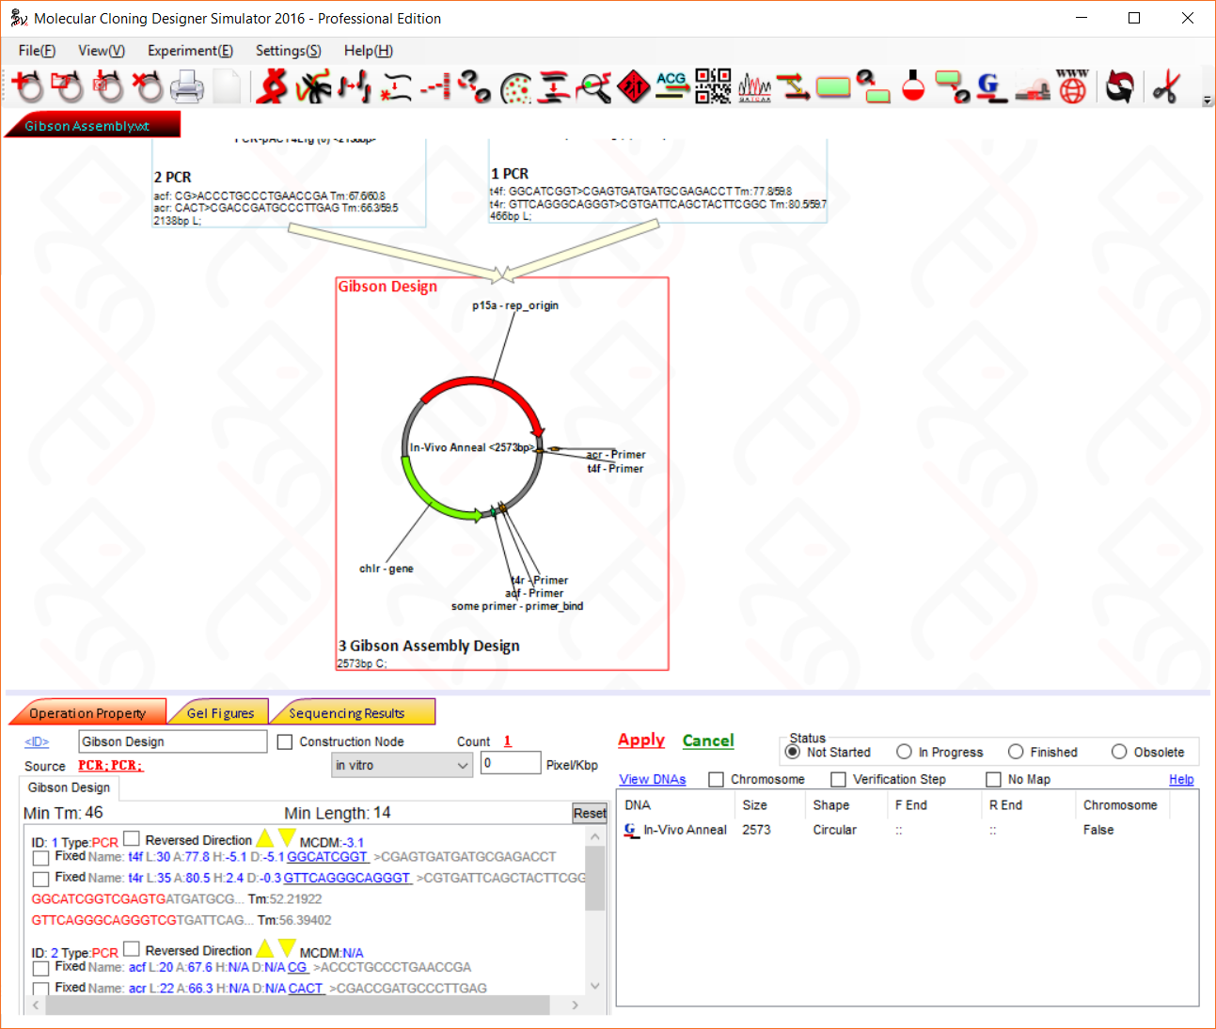
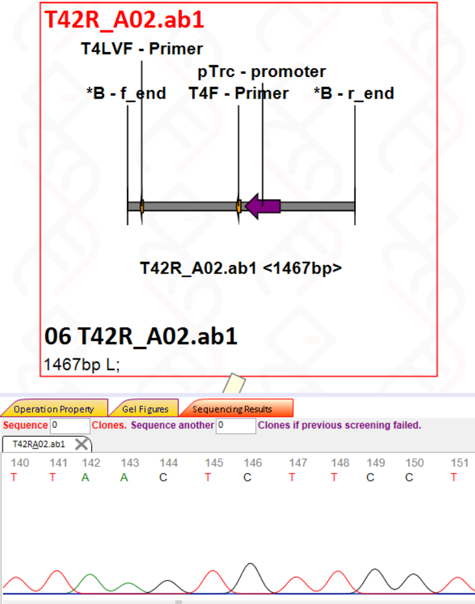
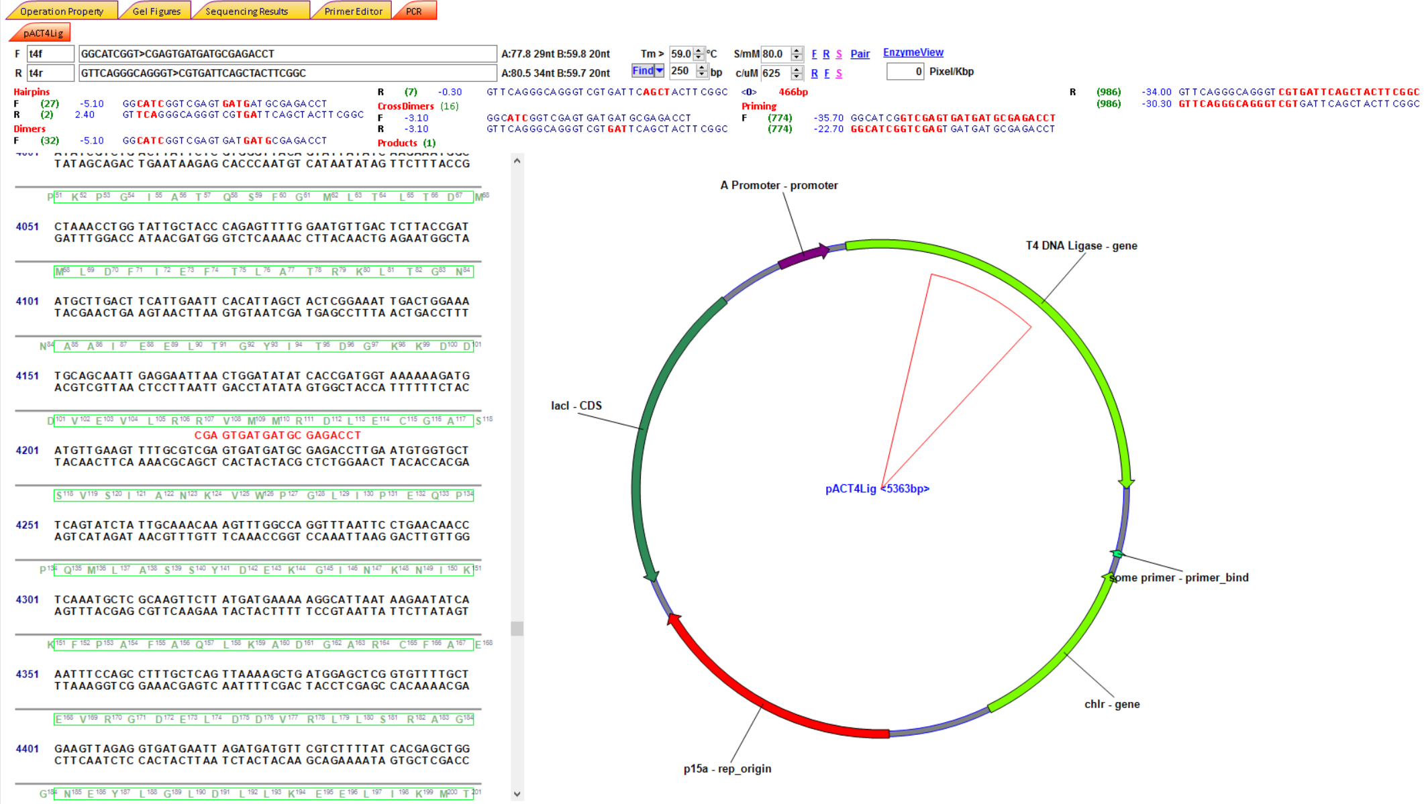

Molecular Cloning Designer Simulator (MCDS)
All-in-one molecular cloning and genetic engineering design, simulation and management software for complex project management
Zhenyu Shi, Claudia E. Vickers. AIBN, the University of Queensland, QLD 4067, Australia.
Highlights
Whole Project Design, Simulation , Overview, Management and Tracking in One Single File Displayed as Flowchart to Secure Your Data integrity.
Automatic Recalculation/Simulation of Every Operations in the Downstream of the Flowchart by Double Click.
Design Multiple Fragment Gibson Assembly with One Click.
Simulation of Almost All Technologies:
PCR, Renzyme digestion, Gel Electrophoresis, Gateway cloning, BioBrick Assembly, Gibson Assembly, Yeast Assembly, Site-specific recombination and assembly (φC31, Bxb1, etc), Lambda red knock-out/knock-in, Homologous recombination, CRISPR digestion, Automatic Feature Annotation, Feature Screening, PCR Screening, Management of Primer List, In situ Primer Design and Primer Search, Sequence Comparison, etc.
User Interface Overview
Example Flowchart
Support for AB1 File
Each node in the flowchart stands for an operation. You can drag, zoom, and click to view/edit details.
Save your sequencing results and comparison in the same project file.
Sequence View and Primer Design Panel
Display of Sequence Alignment
Intuitive flowchart can be printed to guide your wet experiments. It contains every details even digestion buffers.
Interactive sequence viewer and primer designer allows you to design primers by either click in the sequence view or select a region and search.
Easy to identify mismatch/mutations from multiple sequence results.
Available from: https://mcds.codeplex.com/
Scan for Link
MCDS currently supports Windows only. But we are moving to HTML5 soon, which will work in any OS.
Video instructions: https://goo.gl/qFWyDR

